Slide 1
Final Year Project Presentation
77356803
The Last Draw: Card Slayer
Swajan Rajbanshi
1

Slide 2
Table of contents
01
Introduction
05
Product Design
02
06
Aims and Objectives
Tools and Technology
03
07
Methodology
Implementation
04
08
Project Management
SWOT Analysis
2

Slide 3
1
Introduction
The Last Draw: Card Slayer
3

Slide 4
Introduction
What is this Project about?
Why pick game development as the final-year project?
4

Slide 5
2
Aims & Objectives
The Last Draw: Card Slayer
5

Slide 6
Aims:
Create a 2D turn-based card game
Interactive Card Mechanics
Simple but responsive AI
6

Slide 7
Objectives:
Design a system where players manage cards during combat.
Offer various cards that act offensively and defensively.
Create a simple environment for the player to have a turn-based card game.
7

Slide 8
3
Methodology
The Last Draw: Card Slayer
8

Slide 9
Research Methodology:
Guide for the project:
Kehom's Forge: Helped with the creation of AI logic of conditional and chance-based.
The Demon’s Hand (League of Legends): Concept for the card-based game.
Opengameart.org: Assets and idea for asset creation.
9

Slide 10
Method Development Methodology:
Agile
Enables quick testing of small features. (Different Card States)
Flexibility: easy design changes.
Freedom of regular iteration and constant feedback.
10

Slide 11
4
Project Management
The Last Draw: Card Slayer
11

Slide 12
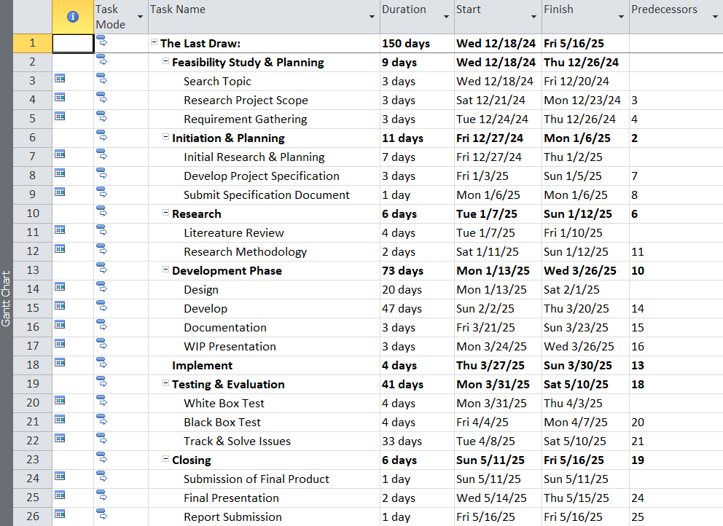
Gantt Chart
12

Slide 13
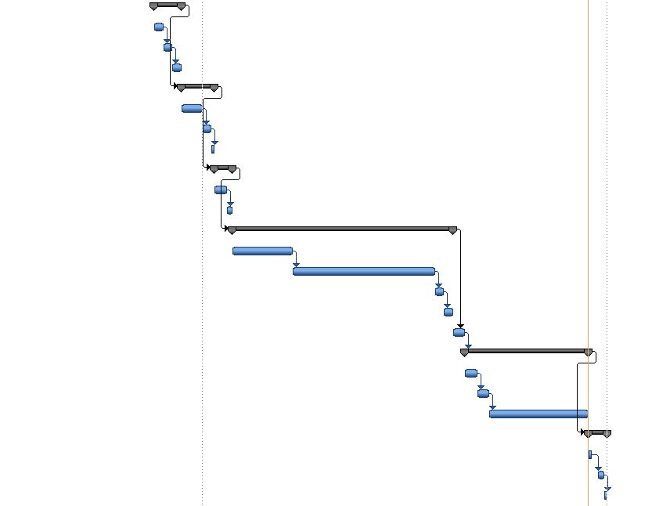
Timeline
13

Slide 14
5
Product Design
The Last Draw: Card Slayer
14

Slide 15
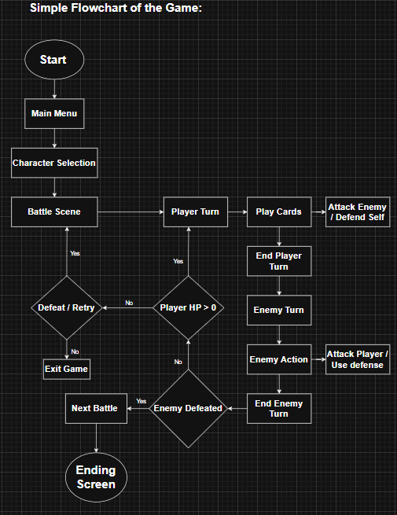
Flowchart:
Main Menu
Character Selection
Battle Scene
Use of the Card
Enemy Response
Result Screen
15

Slide 16
6
Tools & Technology
The Last Draw: Card Slayer
16

Slide 17
Tools & Technology:
Tools
Purpose
Godot
Piskel
Adobe Photoshop
Draw.io
GitHub
PowerPoint
Game development
Pixel art creation
Image editing, post creation
Flowchart, UML, etc.
Version control, backup
Tutorial, & presentation
17

Slide 18
7
Implementation
The Last Draw: Card Slayer
18

Slide 19
Implementation:
Card System:
1
Base
Idle/ Inactive state of the card.
2
Clicked
Card state when user has clicked the card.
3
Dragged
After clicking, the card goes into a dragged state.
4
Released
When dragging is complete, it goes into the released state.
19

Slide 20
Implementation:
Enemy AI:
Conditional:
If a certain enemy’s HP drops below the threshold, a different action is performed.
Chance-based:
Each chance-based action has a weighted value, in order not to make the enemy action random.
Conditional
Chance-based
Enemy AI
20

Slide 21
Implementation:
Battle stages:
Different enemies on different stages.
Different enemies have different attack damage and patterns.
The final boss appears and the end of the game.
Stage 1
Stage 2
Stage 3
Battle Stages
21

Slide 22
8
SWOT Analysis
The Last Draw: Card Slayer
22

Slide 23
SWOT Analysis:
Strengths
Weaknesses
Opportunities
Threats
S
w
O
T
23

Slide 24
SWOT Analysis:
Strengths
S
Turn-based, card combat system.
Modular and scalable.
Working AI model based on conditional and chance-based logic.
Visually appealing assets used and created.
24

Slide 25
SWOT Analysis:
Weakness
W
Limited playtime due to an issue on Godot’s end.
Limited enemy types due to time constraints.
No implementation of story mode.
Hosting the game on the web works slowly as it is heavy on the GPU.
25

Slide 26
SWOT Analysis:
Opportunities
O
Expand the game to include story mode, hence adding more content.
Add more complicated enemy AI behaviors.
Since most of the game is scalable, more new things can be added.
Implementation of a save/load function would go a long way.
26

Slide 27
SWOT Analysis:
Threats
T
Due to a lack of content, constant replayability is hard to achieve.
The game might not work on Linux or other operating systems.
Slightly heavy on the GPU.
Something might go wrong just because it was made in Godot.
27

Slide 28
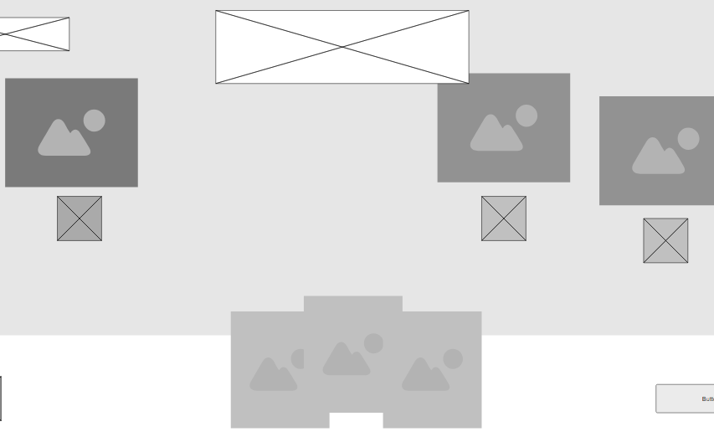
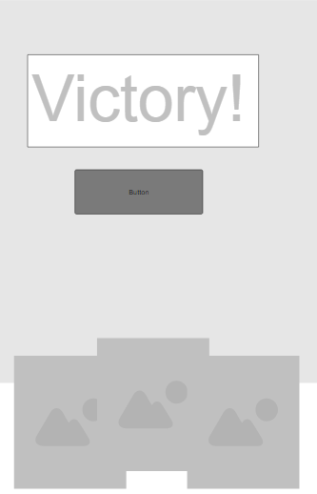
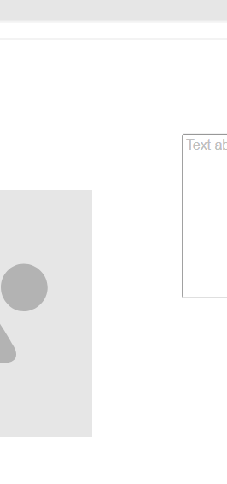
Mockup
28

Slide 29
— Pirate Software
"When you make that game, it will not live up to your imagination you have, the perfect vision in your head. As you solidify that, it will get farther and farther from that perfect vision, and you have to be okay with that. That is normal."
29

Slide 30
Thank You
Swajan Rajbanshi
30

